Slide 1
Lending Club:
Risk Assessment
Orange Group 2: Sally Crouch, Octavio Cortes, Mckayla Lein,
Jacob Hyman, Adam Cottrell, Ashwin Balasubramanian
Notes:
Ineffiencies > Recession vs. Not Recession (2007-2009)
Education ***
WF Loans
Major Purchase
Employment 3 years
States where no defaults***
Renewable Energy ****
Small Business***
Vacation

Slide 2

Some loans are RiskIER THAN you think.

Slide 3
01.
Data exploration
03. Risk ANALYSIS
02. METHODOLOGY
04.
Key Takeaways
AGENDA

Slide 4
Data
Exploration
Data Exploration
Methodology
Risk Analysis
Key Takeaways
Questions

Slide 5
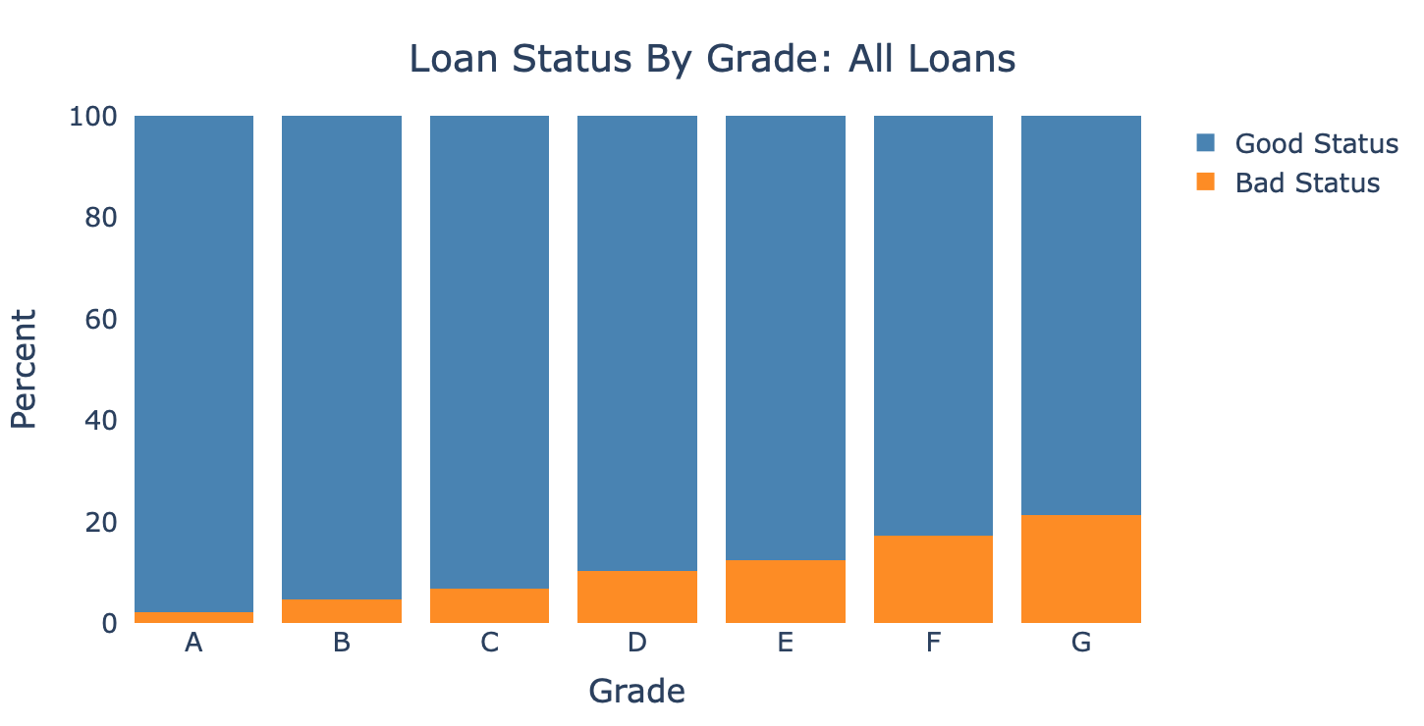
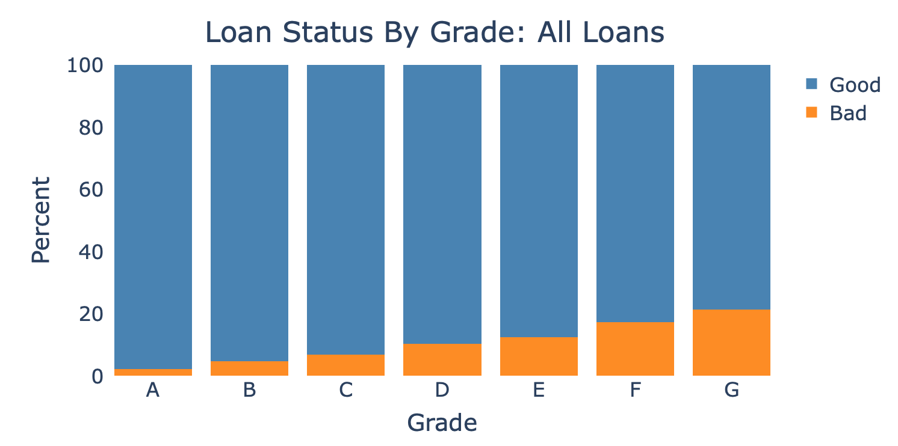
More
Risk
Less
Risk
Data Exploration
Methodology
Risk Analysis
Key Takeaways
Questions
Notes:
Mckayla

Slide 6
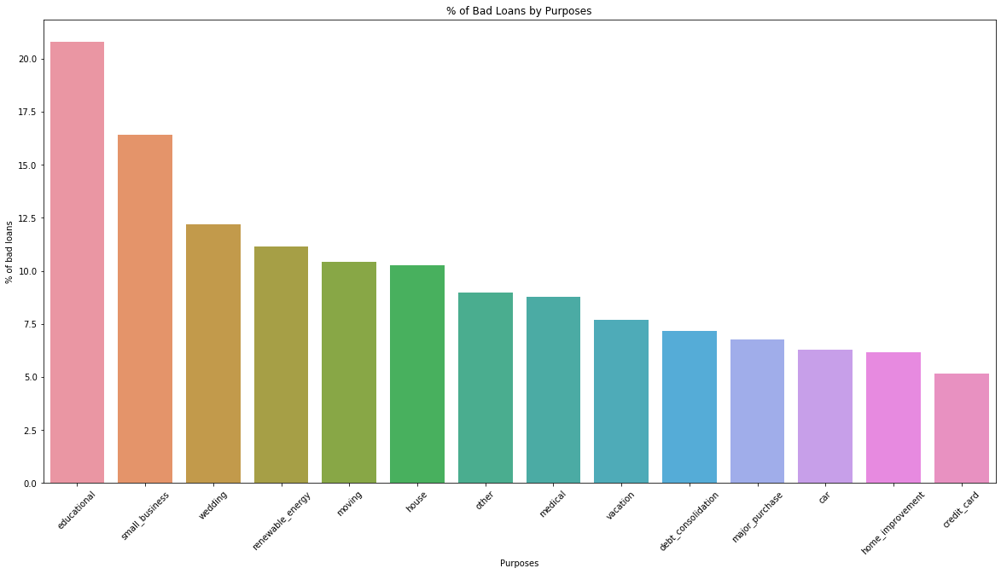
Data Exploration
Methodology
Risk Analysis
Key Takeaways
Questions

Slide 7
Methodology
Data Exploration
Methodology
Risk Analysis
Key Takeaways
Questions

Slide 8
Status
Grades
Purposes
Data Exploration
Methodology
Risk Analysis
Key Takeaways
Questions

Slide 9


Good STATUS vs. Bad STATUS
Data Exploration
Methodology
Risk Analysis
Key Takeaways
Questions

Slide 10
Good Status vs. Bad status
Fully paid off
Current
Grace Period
Default
Charged Off
Late
Data Exploration
Methodology
Risk Analysis
Key Takeaways
Questions

Slide 11
More
Risk
Less
Risk
Data Exploration
Methodology
Risk Analysis
Key Takeaways
Questions
Notes:
Mckayla

Slide 12
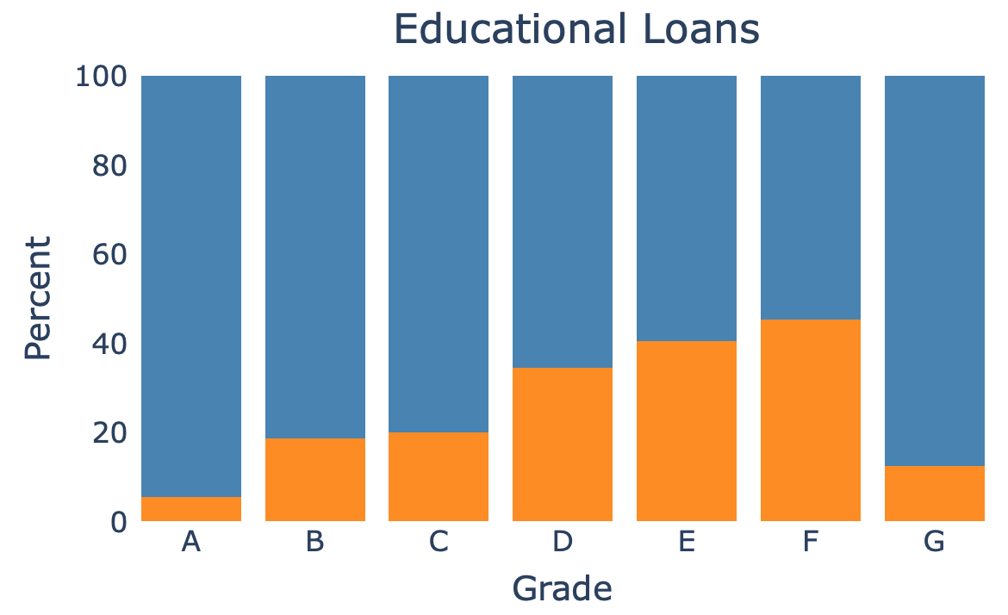
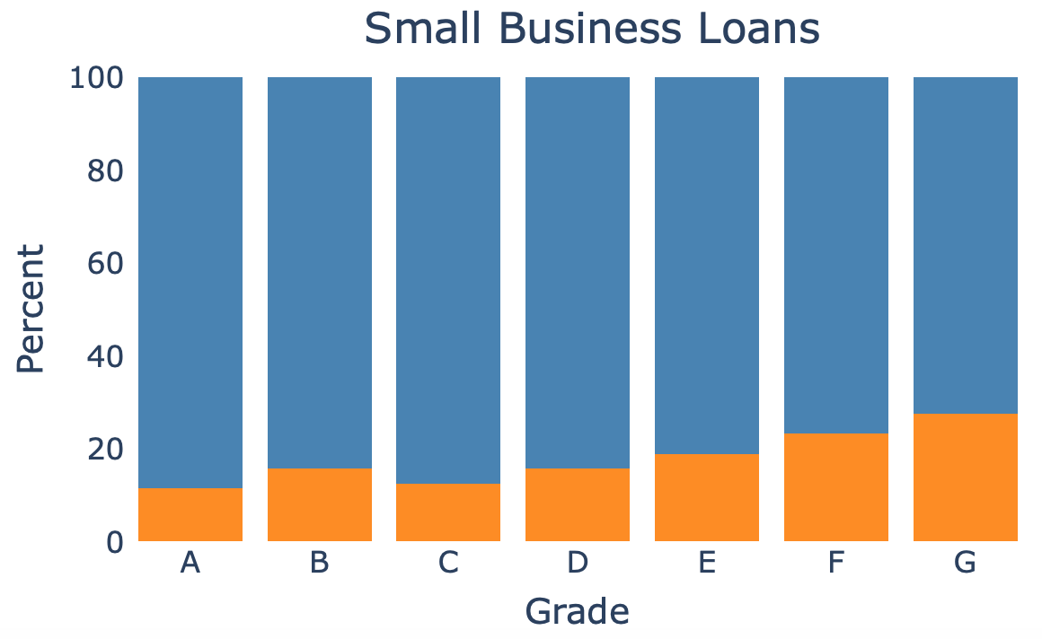
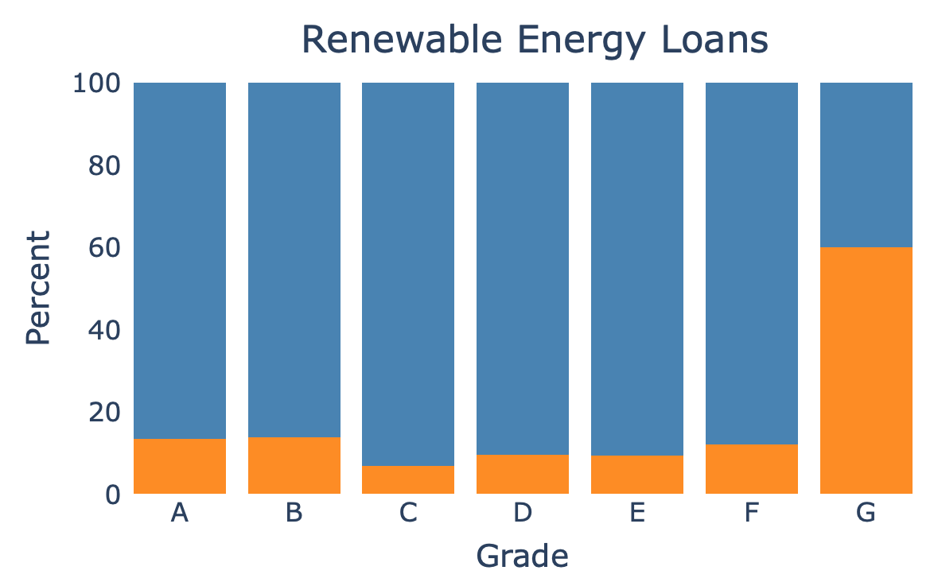
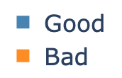
Data Exploration
Methodology
Risk Analysis
Key Takeaways
Questions

Slide 13
Loan Grades
A B C D E F G
High Risk Grades
Low Risk Grades
Data Exploration
Methodology
Risk Analysis
Key Takeaways
Questions

Slide 14
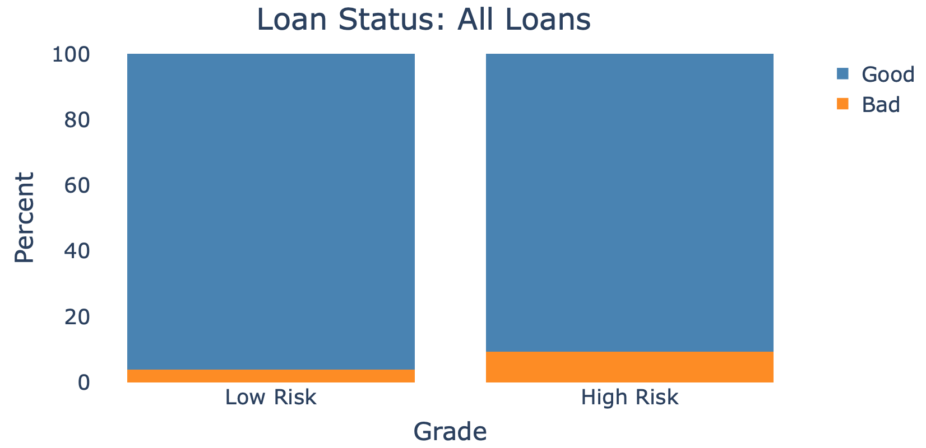
9.4%
3.9%
Data Exploration
Methodology
Risk Analysis
Key Takeaways
Questions

Slide 15
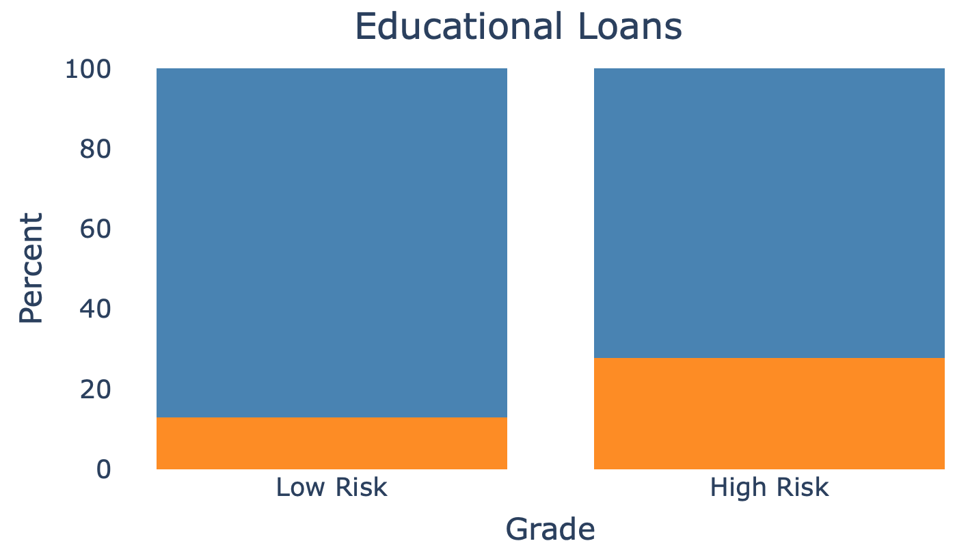
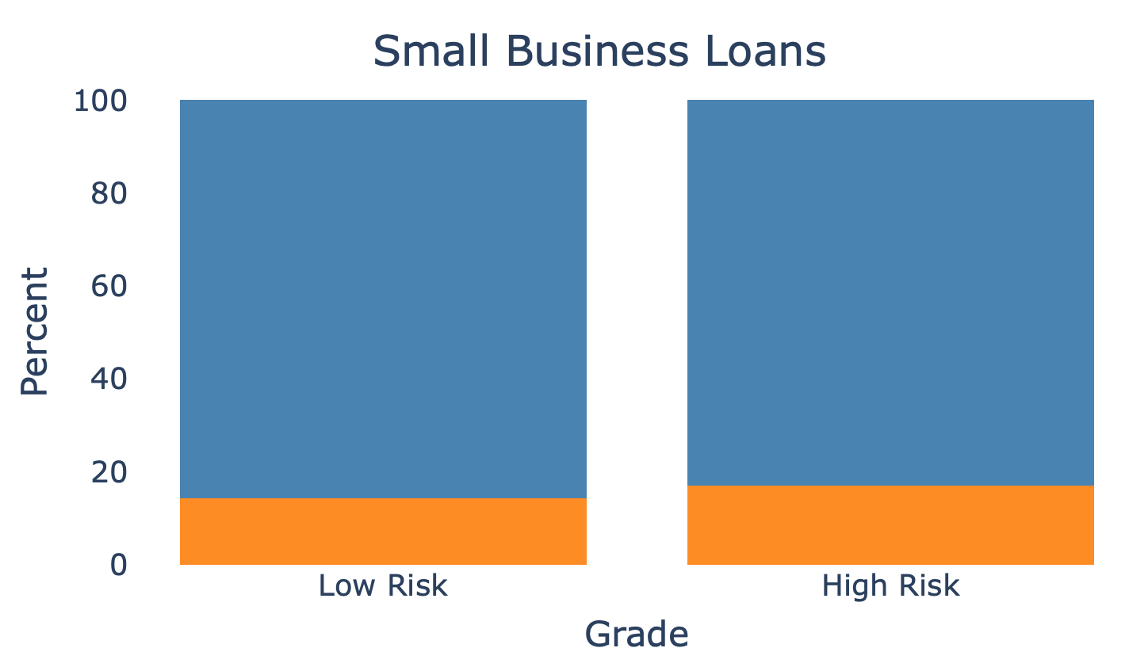
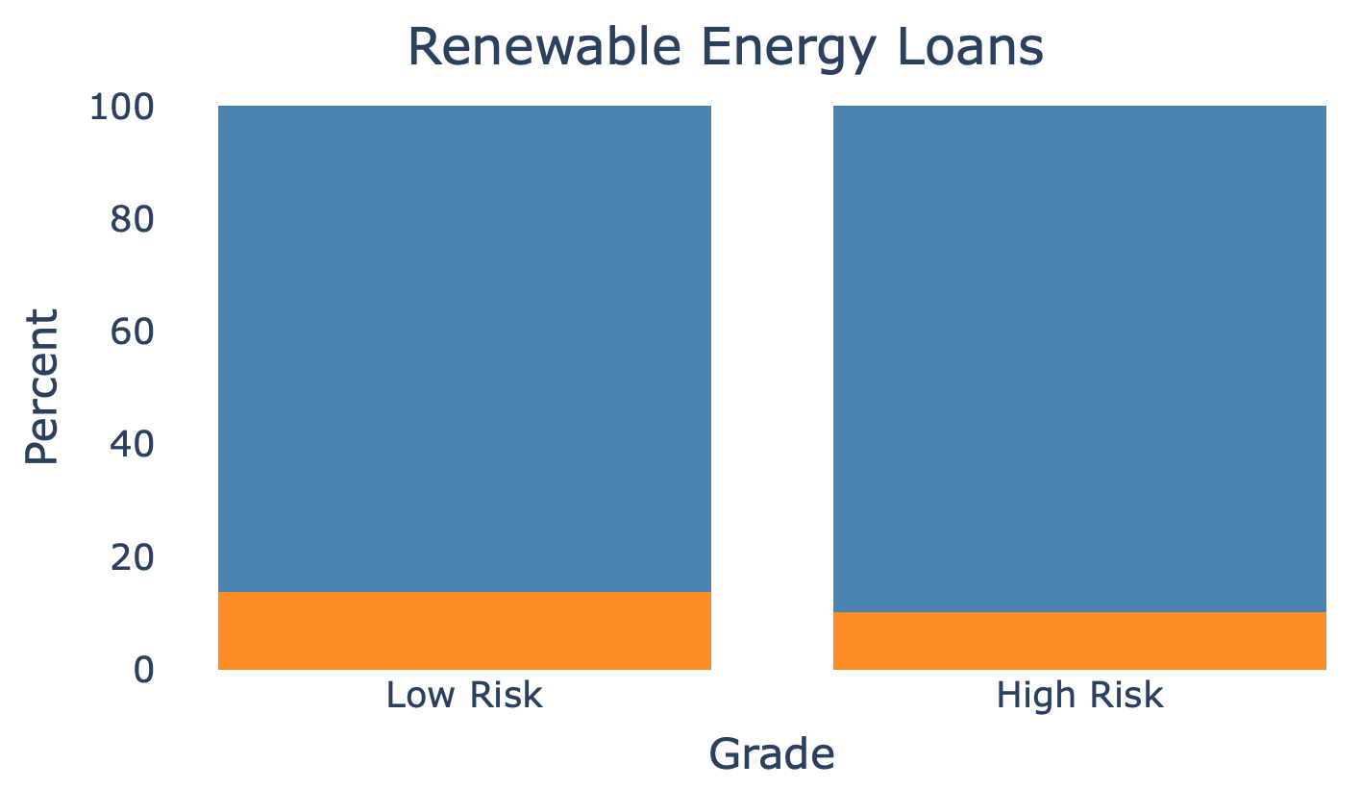
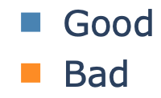
27.8%
13%
14.3%
17%
13.8%
10.2%
Data Exploration
Methodology
Risk Analysis
Key Takeaways
Questions

Slide 16
Risk
Analysis
Data Exploration
Methodology
Risk Analysis
Key Takeaways
Questions

Slide 17
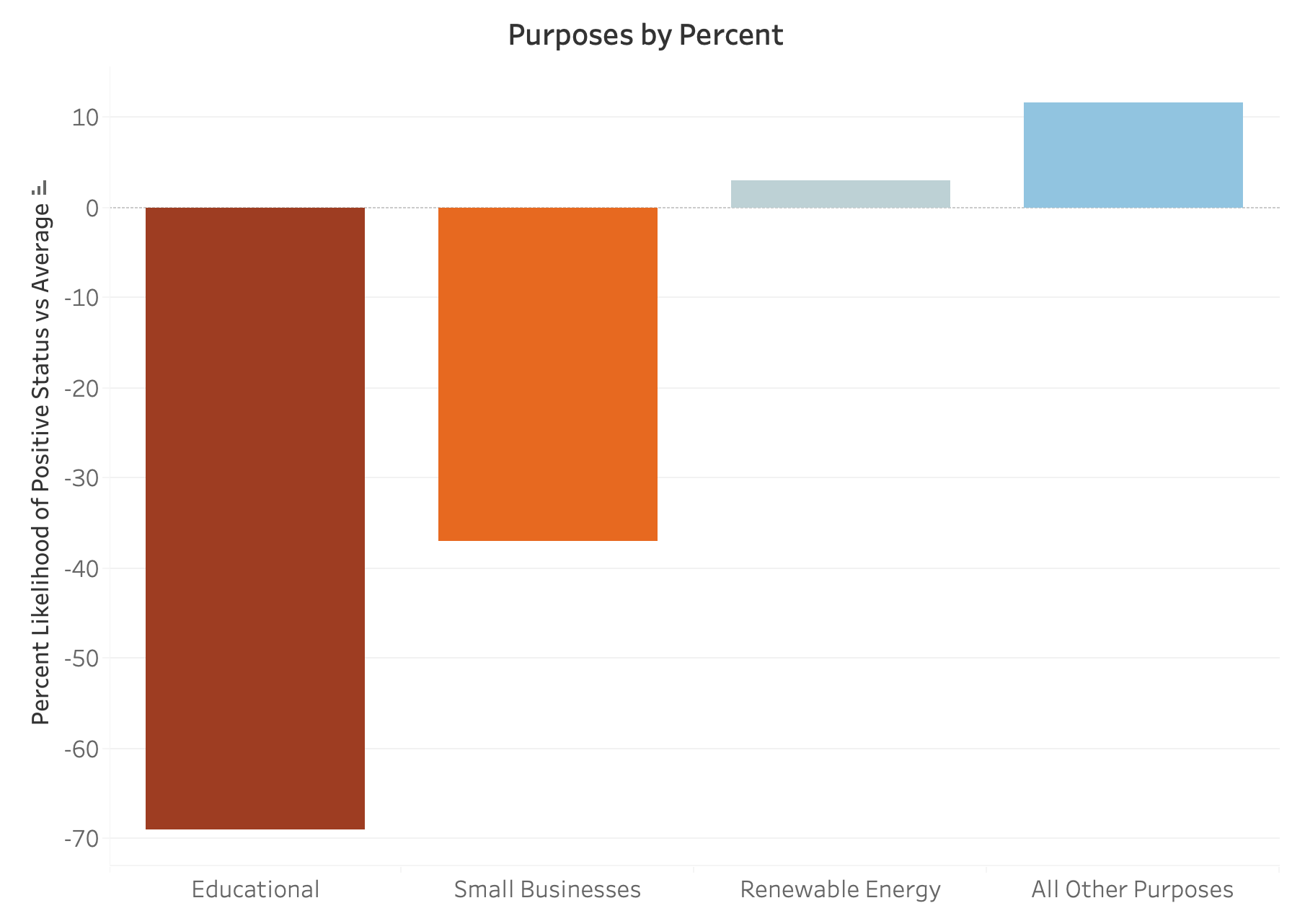
Data Exploration
Methodology
Risk Analysis
Key Takeaways
Questions

Slide 18
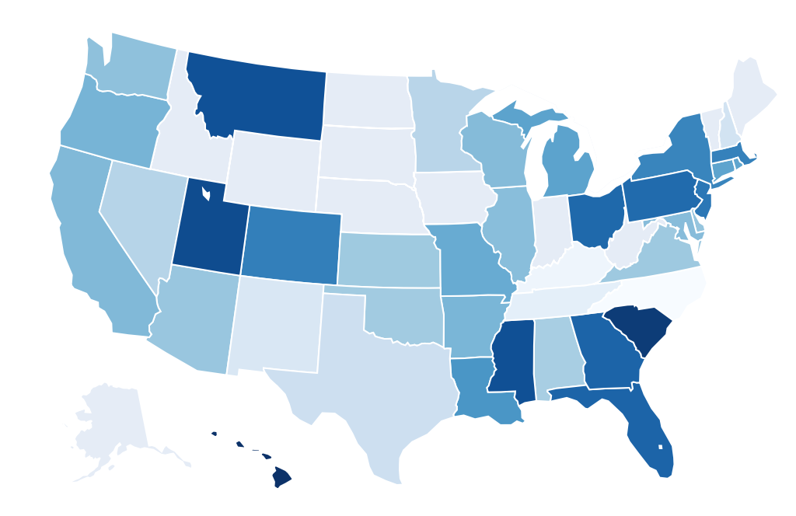
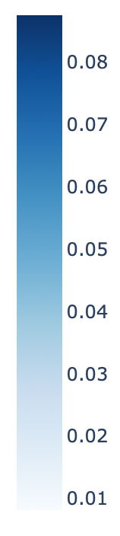
Percent of Educational Loans By State
Data Exploration
Methodology
Risk Analysis
Key Takeaways
Questions

Slide 19
Grades Vs Our Model
Positive or negative status predicted by... | C stat
Grades | 0.68
Our Model | 0.65
Data Exploration
Methodology
Risk Analysis
Key Takeaways
Questions

Slide 20
Predictors
Variable | Increased Odds of Payback
1 less credit inquiry in last 6 months | 1.24
Employed longer than 10 yrs | 2.212
Data Exploration
Methodology
Risk Analysis
Key Takeaways
Questions

Slide 21
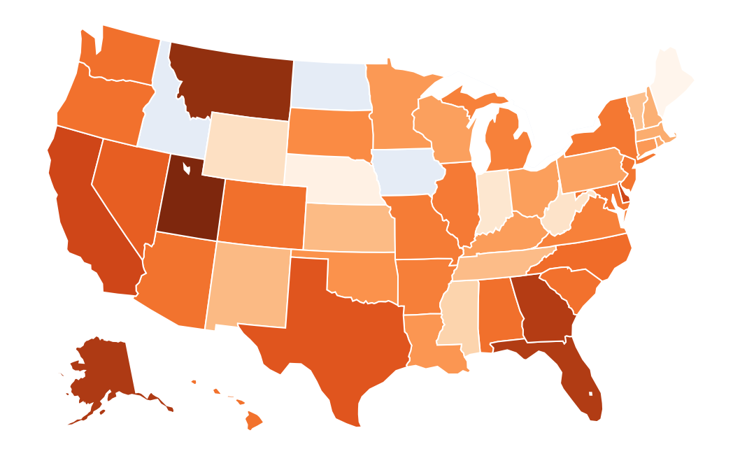
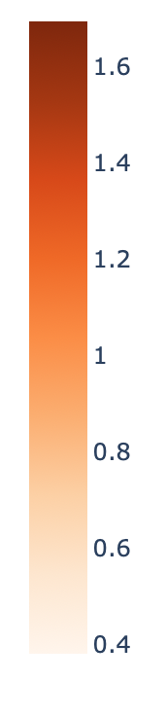
Percent of small business loans by state
Data Exploration
Methodology
Risk Analysis
Key Takeaways
Questions

Slide 22
Grades Vs OUR Model
Positive or negative status predicted by... | C stat
Grades | 0.52
Our Model | 0.62
Data Exploration
Methodology
Risk Analysis
Key Takeaways
Questions

Slide 23
Predictors
Variable | Increased Odds of Payback
Employed longer than 10yrs | 1.263
Initial listing status = whole | 2.247
1 less credit inquiry in last 6 months | 1.23
1 less Public record | 1.164
1% less Revolving credit line utilization rate | 1.006
Data Exploration
Methodology
Risk Analysis
Key Takeaways
Questions

Slide 24
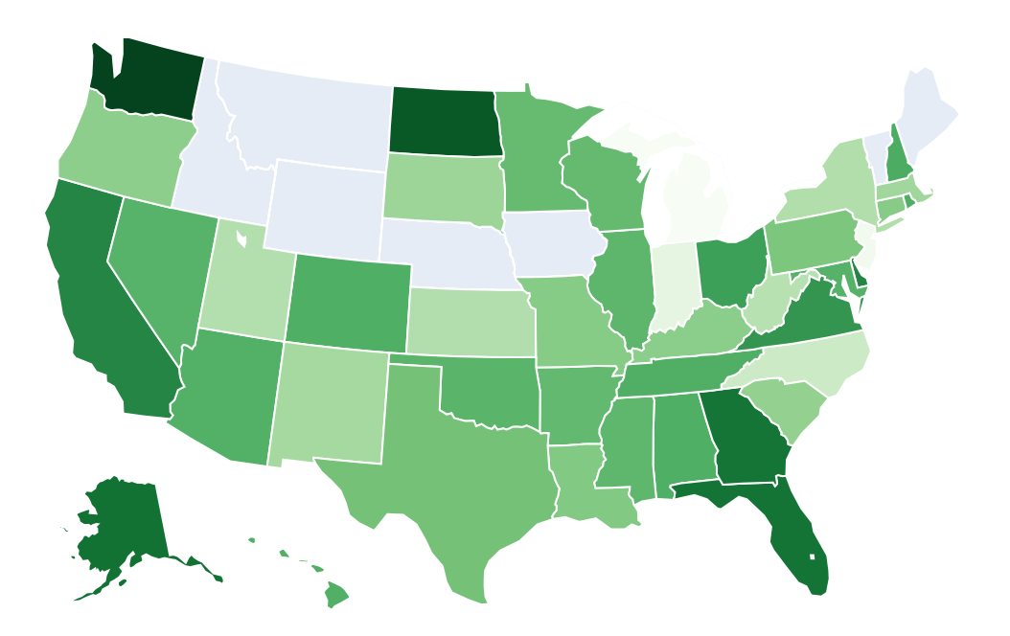
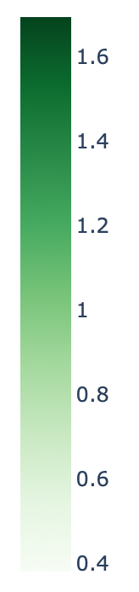
Percent of RenewAble Energy Loans By State
Data Exploration
Methodology
Risk Analysis
Key Takeaways
Questions
Notes:
Now we will turn our attention to renewable energy loans. Here we see the distribution of these loans across states. Darker areas show where there are proportionally more loans being taken for renewable energy projects.

Slide 25
Grades Vs OUR Model
Positive or negative status predicted by... | C stat
Grades | 0.56
Our Model | 0.62
Predictors:
Employment Length ▪ Term ▪ Inquiries in the Last 6mo ▪ Loan Amount ▪ Log of Annual Income ▪
Log of Revolving Balances ▪ Utilization of Revolving Credit
Data Exploration
Methodology
Risk Analysis
Key Takeaways
Questions
Notes:
As before, we found variables that would indicate loan status. Again we use the c-statistic to evaluate how well each model performs. Our model using several predictors, listed at the bottom, seems to fare better than a model solely based on the grading system. As you will recall, grade was not able to accurately assess the riskiness of loans in this category. A & B grade loans actually fared worse than lower grades, so it makes sense that our model would do a bit better at predicting loan status.

Slide 26
Predictors
Variable | Increased Odds of Payback
~3-fold increase in income | 2.1
Employed Longer than 10yrs | 2.0
36mo vs 60mo | 1.6
1 less credit inquiry in 6mo | 1.3
~3-fold increase in revolving balances | 1.3
10% less credit utilization | 1.2
Loan lessened by $1000 | 1.1
Variable | Increased Odds of Payback
~3-fold increase in income | 2.1
Employed Longer than 10yrs | 2.0
36mo vs 60mo | 1.6
1 less credit inquiry in 6mo | 1.3
~3-fold increase in revolving balances | 1.3
10% less credit utilization | 1.2
Loan lessened by $1000 | 1.1
Data Exploration
Methodology
Risk Analysis
Key Takeaways
Questions
Notes:
While we use several variables in our predictive model, we will draw your attention to a few that seem to be stronger predictors of loan performance. Increasing annual income, decreasing credit utilization, and smaller loan amounts are particularly associated with the likelihood of a loan remaining in positive status.

Slide 27
Key
Takeaways
Data Exploration
Methodology
Risk Analysis
Key Takeaways
Questions

Slide 28
Loan Grades InAccurate For...
Education
Small Business
Renewable Energy
Data Exploration
Methodology
Risk Analysis
Key Takeaways
Questions

Slide 29
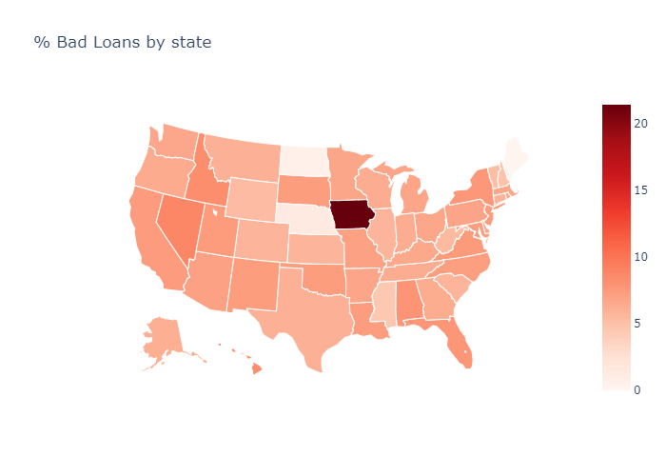
Some States PERFORM Worse Than Others
Data Exploration
Methodology
Risk Analysis
Key Takeaways
Questions

Slide 30
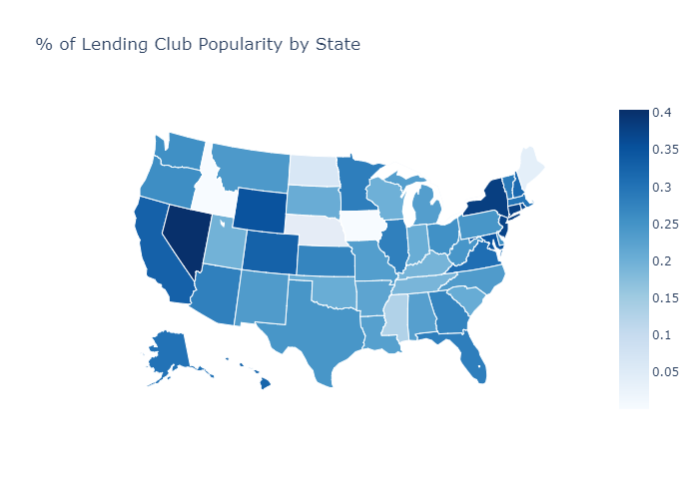
Increase lending club reach
Data Exploration
Methodology
Risk Analysis
Key Takeaways
Questions

Slide 31
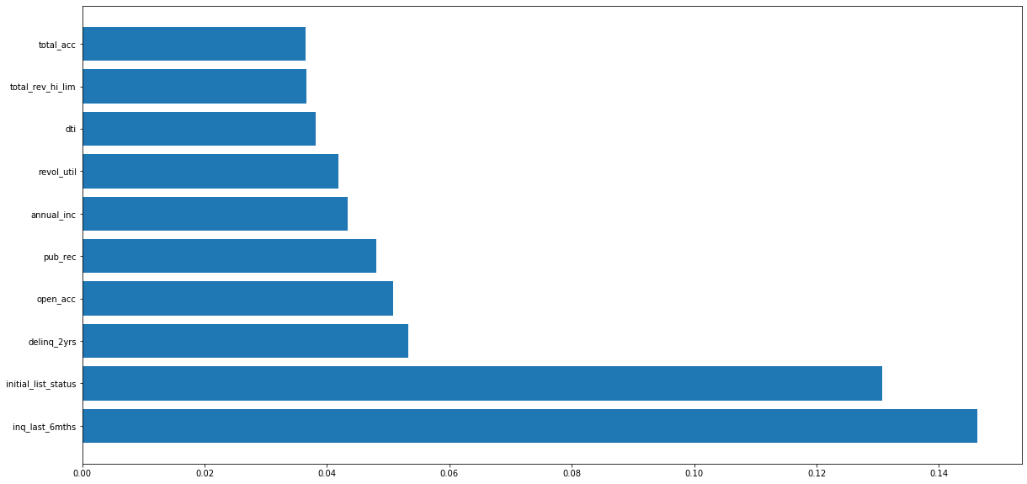
Useful variables for modeling
Data Exploration
Methodology
Risk Analysis
Key Takeaways
Questions

Slide 32
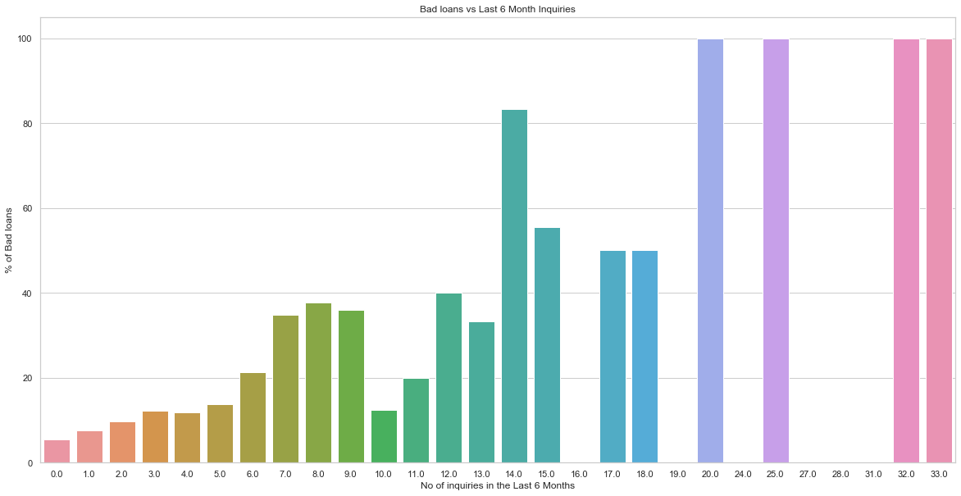
Data Exploration
Methodology
Risk Analysis
Key Takeaways
Questions

Slide 33
Next steps
Loan Maturity
More Robust Models
Deeper Dive into other categories and variables
Data Exploration
Methodology
Risk Analysis
Key Takeaways
Questions
Notes:
Lastly, we will leave you with some next steps and final considerations.
First, we want to be asking ourselves what financial nuances need attending to? One limitation we encountered was dealing with loan maturity. Some of these loans have not reached the end of their terms, so “good’ and “bad” status might be fluid.. With more time, we would like to analyze how loans migrate statuses over the course of their repayment.
Second, our exploration raised the need for greater model complexity. As an example, think about loan size and annual income. Both factors alone are important in whether a borrower can repay a loan, but in conjunction may be even more impactful. A large loan would present a bigger burden to someone with a smaller income. With more time, we would want to build models taking into account these types of interactions.
Finally, we would encourage Lending Club to continue to be open areas where the grading system assesses risk poorly. We have seen three in particular during this presentation -- loans for education, renewables and small businesses. In areas like these, the algorithm assigning grades is missing important information, and Lendingn Club should dive deeper into which variables prove important for modeling. This will be key to protecting Lending Club and its investors from unnecessary risk.
With that, we thank you for your time, and invite any questions or comments you may have.

Slide 34

Data Exploration
Methodology
Risk Analysis
Key Takeaways
Questions

